Slide 1
持续集成 ——配置与项目演示
戴娟 黄栋 梁建均

Slide 2
Agenda
Tech Basic
Maven
Demo Project
Build & Deploy Process
Q & A
Git & Github
Hudson
More
Integrate Policy
Start Project Step by Step

Slide 3
Part 1: Tech Basic

Slide 4
Git & Github
Git使用简易指南
Github：源码托管系统；与git配合使用

Slide 5



What is ?
Maven is a build automation tool typically used for Java projects. Maven serves a similar purpose to the Apache Ant tool, but it is based on different concepts and works in a profoundly different manner. It can also be used to build and manage projects written in C#, Ruby, Scala, and other languages.
Apache Maven is a software project management and comprehension tool. Based on the concept of a project object model (POM), Maven can manage a project's build, reporting and documentation from a central piece of information.
Notes:
Maven是一个项目管理工具，它包含了:
一个项目对象模型 (Project Object Model)，
一组标准集合，
一个项目生命周期(Project Lifecycle)，
一个依赖管理系统(Dependency Management System)，
和用来运行定义在生命周期阶段(phase)中插件(plugin)目标(goal)的逻辑。

Slide 6
Maven’s Objectives
■ Making the build process easy
■ Providing a uniform build system
■ Providing quality project information
■ Providing guidelines for best practices development
■ Allowing transparent migration to new features
Notes:
1 屏蔽构建底层的细节
2 使用POM和一系列maven 工程共享的插件这样统一的构建系统
3 可以在POM或者项目资源中提供足够的信息：
Change log document created directly from source control
Cross referenced sources
Mailing lists
Dependency list
Unit test reports including coverage
4 譬如对测试的指导

Slide 7
Convention Over Configuration
Directory name | Purpose
project home | Contains the pom.xml and all subdirectories.
src/main/java | Contains the deliverable Java sourcecode for the project.
src/main/resources | Contains the deliverable resources for the project, such as property files.
src/test/java | Contains the testing classes (JUnit or TestNG test cases, for example) for the project.
src/test/resources | Contains resources necessary for testing.
You can also custom most of the properties as you like.
Notes:
约定优于配置
Ruby on Rails
EJB3

Slide 8
Maven vs. Ant
Is Maven an alternative to Ant ?
Yes! But more than a build tool!
Maven isn’t totally defined by the mechanics of your build system. It isn’t about scripting the various tasks in your build as much as it is about encouraging a set of standards, a common interface, a life-cycle, a standard repository format, a standard directory layout, etc.
Platform
Notes:
Maven并不是完全根据你构建系统的机制来定义的，它不是为你构建的不同任务编写脚本，它提倡一组标注，一个一般的接口，一个生命周期，一个标准的仓库格式，一个标准的目录布局，等等。

Slide 9
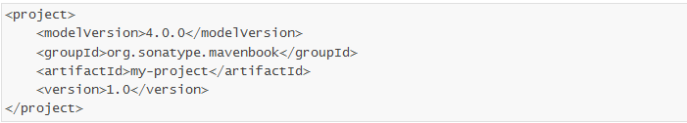
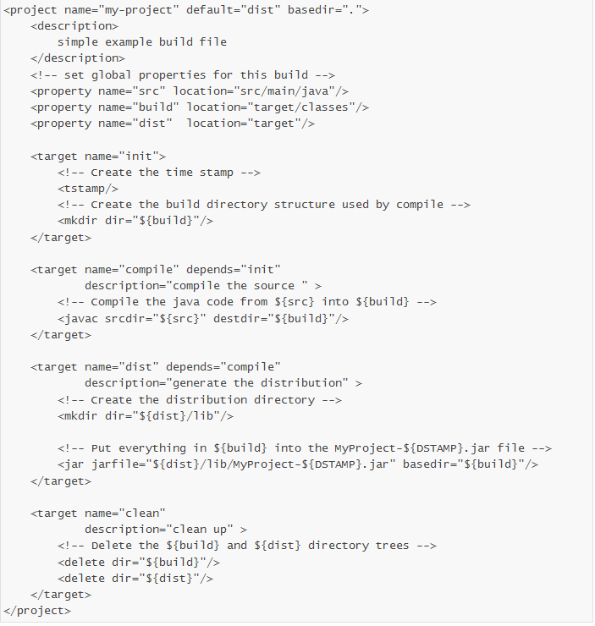
Maven vs. Ant
Maven | Ant
Standard build file | project.xml & maven.xml | build.xml
Properties process sequence | ${maven.home}/bin/driver.properties ${project.home}/project.properties ${project.home}/build.properties ${user.home}/build.properties -D command The last make sense。 | -D command <property> FCFS
Constructing rules | Dynamic XML based on Jelly | More or less static unless use <script> task
Extension Language | Jelly（XML) | Java
Constructing rules scalability | <preGoal> & <postGoal> | <script>
Ant has no conventions
Ant is procedural
Ant doesn’t have a lifecycle
Notes:
Maven has conventions
Maven is declarative
Maven has a lifecycle which was invoked when you executed mvn install

Slide 10
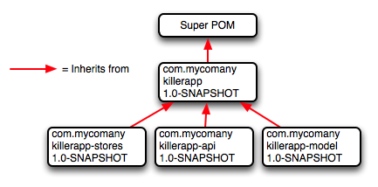
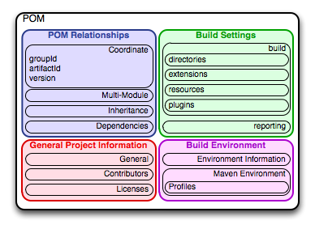
Concepts
The Project Object Model
The Super POM
The Effective POM
mvn help:effective-pom
Notes:
General project information
This includes a project’s name, the URL for a project, the sponsoring organization, and a list of developers and contributors along with the license for a project.
Build settings
In this section, we customize the behavior of the default Maven build. We can change the location of source and tests, we can add new plugins, we can attach plugin goals to the lifecycle, and we can customize the site generation parameters.
Build environment
The build environment consists of profiles that can be activated for use in different environments. For example, during development you may want to deploy to a development server, whereas in production you want to deploy to a production server. The build environment customizes the build settings for specific environments and is often supplemented by a custom settings.xml in ~/.m2.
POM relationships
A project rarely stands alone; it depends on other projects, inherits POM settings from parent projects, defines its own coordinates, and may include submodules.

Slide 11
The Build Lifecycle
A Maven lifecycle consists of a sequence of named phases: prepare-resources, compile, package, and install among other.
A build lifecycle is an organized sequence of phases that exist to give order to a set of goals. Those goals are chosen and bound by the packaging type of the project being acted upon. There are three standard lifecycles in Maven: clean, default (sometimes called build) and site.

Slide 12
Clean Lifecycle(clean)-----mvn clean
pre-clean
clean
post-clean
Notes:
目标clean:clean通过删除构建目录删除整个构建的输出。

Slide 13
Default Lifecycle(Default)
Lifecycle Phase | Description
validate | Validate the project is correct and all necessary information is available to complete a build
generate-sources | Generate any source code for inclusion in compilation
process-sources | Process the source code, for example to filter any values
generate-resources | Generate resources for inclusion in the package
process-resources | Copy and process the resources into the destination directory, ready for packaging
compile | Compile the source code of the project
process-classes | Post-process the generated files from compilation, for example to do bytecode enhancement on Java classes
generate-test-sources | Generate any test source code for inclusion in compilation
process-test-sources | Process the test source code, for example to filter any values
generate-test-resources | Create resources for testing
process-test-resources | Copy and process the resources into the test destination directory
test-compile | Compile the test source code into the test destination directory
test | Run tests using a suitable unit testing framework. These tests should not require the code be packaged or deployed
prepare-package | Perform any operations necessary to prepare a package before the actual packaging. This often results in an unpacked, processed version of the package (coming in Maven 2.1+)
package | Take the compiled code and package it in its distributable format, such as a JAR, WAR, or EAR
pre-integration-test | Perform actions required before integration tests are executed. This may involve things such as setting up the required environment
integration-test | Process and deploy the package if necessary into an environment where integration tests can be run
post-integration-test | Perform actions required after integration tests have been executed. This may include cleaning up the environment
verify | Run any checks to verify the package is valid and meets quality criteria
install | Install the package into the local repository, for use as a dependency in other projects locally
deploy | Copies the final package to the remote repository for sharing with other developers and projects (usually only relevant during a formal release)
Notes:
目标clean:clean通过删除构建目录删除整个构建的输出。

Slide 14
Site Lifecycle(site)------mvn site
pre-site
site
post-site
site-deploy
Notes:
目标clean:clean通过删除构建目录删除整个构建的输出。

Slide 15
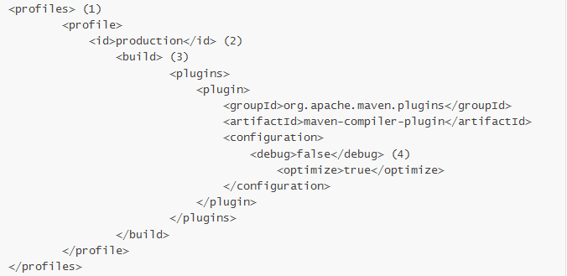
Build Profiles
Profiles allow for the ability to customize a particular build for a particular environment; profiles enable portability between different build environments.
Non-Portable Builds
Environment Portability
Organizational (In-House) Portability
Wide (Universal) Portability
Notes:
A profile can override an element shown with ellipses. A profile can override the final name of a project’s artifact in a profile, the dependencies, and the behavior of a project’s build via plugin configuration. A profile can also override the configuration of distribution settings depending on the profile

Slide 16
Hello world!
S1 Writing a POM
<?xml version="1.0" encoding="UTF-8"?>
<project xmlns=http://maven.apache.org/POM/4.0.0 xmlns:xsi="http://www.w3.org/2001/XMLSchema-instance" xsi:schemaLocation="http://maven.apache.org/POM/4.0.0 http://maven.apache.org/xsd/maven-4.0.0.xsd">
<modelVersion>4.0.0</modelVersion>
<groupId>cn.edu.nju.software</groupId>
<artifactId>helloworld</artifactId>
<version>1.0-SNAPSHOT</version>
<name> Maven Hello World Project</name>
</project>
Notes:
与Java代码解耦

Slide 17
Hello world!
S2 Writing Main Code
package cn.edu.nju.software.helloworld;
public class HelloWorld
{
public String sayHello(){
return "Hello Maven";
}
public static void main(String args []){
System.out.println( new HelloWorld().sayHello());
}
}
Notes:
与Java代码解耦

Slide 18
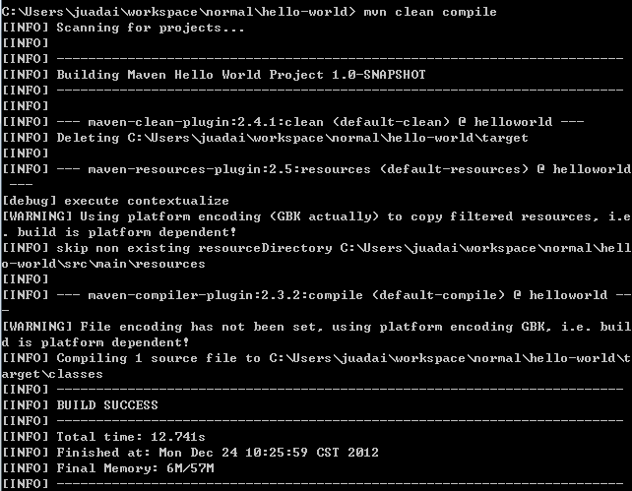
Hello world!
S3 mvn clean compile
Notes:
与Java代码解耦

Slide 19
Hello world!
S4-1 writing test code
<?xml version="1.0" encoding="UTF-8"?>
<project xmlns=http://maven.apache.org/POM/4.0.0 xmlns:xsi="http://www.w3.org/2001/XMLSchema-instance" xsi:schemaLocation="http://maven.apache.org/POM/4.0.0 http://maven.apache.org/xsd/maven-4.0.0.xsd">
<modelVersion>4.0.0</modelVersion>
<groupId>cn.edu.nju.software</groupId>
<artifactId>helloworld</artifactId>
<version>1.0-SNAPSHOT</version>
<name> Maven Hello World Project</name>
<dependencies>
<dependency>
<groupId>junit</groupId>
<artifactId>junit</artifactId>
<version>4.8.2</version>
<scope> test </scope>
</dependency>
</dependencies>
</project>
Notes:
与Java代码解耦

Slide 20
Hello world!
S4-2 writing test code
package cn.edu.nju.software.helloworld;
import static org.junit.Assert.assertEquals;
import org.junit.Test;
public class HelloWorldTest
{
@Test
public void sayHelloTest(){
HelloWorld hi = new HelloWorld();
String result=hi.sayHello();
assertEquals("Hello Maven", result);
}
}
Notes:
与Java代码解耦

Slide 21
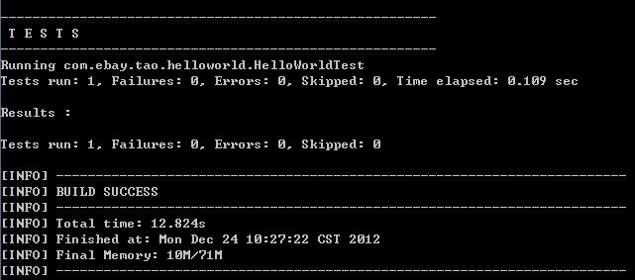
Hello world!
S5 mvn clean test
Notes:
与Java代码解耦

Slide 22
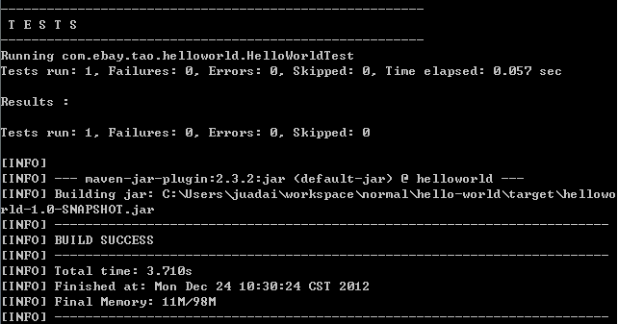
Hello world!
S6 mvn clean package
Notes:
与Java代码解耦

Slide 23
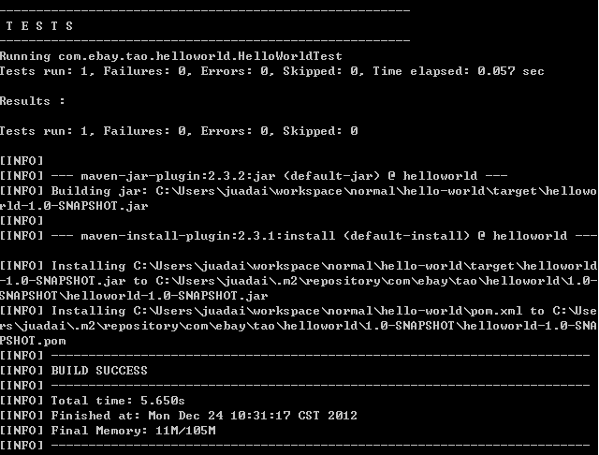
Hello world!
S7 mvn clean install
Notes:
与Java代码解耦

Slide 24
Hello world!
S8 add plugins
<build>
<plugins>
<plugin>
<groupId>org.apache.maven.plugins</groupId>
<artifactId>maven-shade-plugin</artifactId>
<version>1.2.1</version>
<executions>
<execution>
<phase>package</phase>
<goals>
<goal>shade</goal>
</goals>
<configuration>
<transformers>
<transformer implementation="org.apache.maven.plugins.shade.resource.ManifestResourceTransformer“>
<mainClass>cn.edu.nju.software.helloworld.HelloWorld</mainClass>
</transformer>
</transformers>
</configuration>
</execution>
</executions>
</plugin>
</plugins>
</build>
Notes:
与Java代码解耦

Slide 25
Hello world!----- use archetype
mvn archetype:generate
Define your own archetype!!!
Notes:
与Java代码解耦

Slide 26
Further learning
Maven: The Complete Reference
http://www.sonatype.com/books/mvnref-book/reference/public-book.html
Maven introduction:
http://maven.apache.org/index.html
< Maven in action > (《Maven 实战》)
Notes:
Maven Assemblies
Properties and Resource Filtering
Site Generation
Writing Plugins
Developing with Flexmojos
Android Application Development with Maven

Slide 27

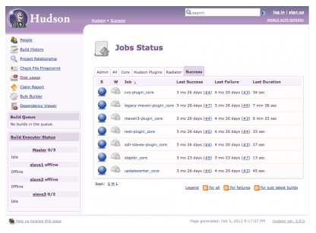
Hudson（or Jenkins）
Two jobs:
1 Building/testing software projects continuously
2 Monitoring executions of externally-run jobs

Slide 28
Hudson-cont
Industry standard products supported by Hudson
SCM vendors: Git, CVS, SVN, Perforce, Mercurial, Team Foundation
Build tools: Ant, maven, gradle, MSBuild, Nant, Rake
Unit Testing frameworks: JUnit, NUnit, Selenium, CppUnit, TestNg, XUnit
Code Coverage tools: Clover, Cobertura, Emma, Serenity, Sonar, NCover, Jacoco
Code Analysis Tools: Checkstyle, PMD, Dry, Findbugs, Warnings, CCM, Violations
Security Tools: LDAP, Active Directory, Crowd, OpenID
Applications servers: Weblogic, Glassfish, Tomcat, JBoss, IIS, JRebel
Virtual Environment: EC2, Virtual Box, VmWare, JCloud
Social communication: E-mail, IRC, Jabber, SMS, Twitter

Slide 29
Part 2: Demo Project

Slide 30
Build and Deploy Process
Hudson Server
Build
Deploy
Binaries repository
Retrieve Source Code
Push source code to github
Git Server
Source Code repository
IDE:
Code
Maven Build

Slide 31
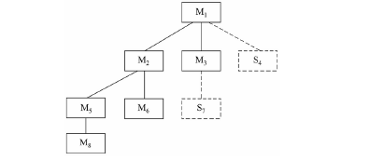
Integrate Policy
S1 class design(interfaces)
S2 A top driver, interfaces & stubs
S3 write class implementations replacing the stubs
S4 integrating
S4 do S3-S4 level by level
S5 write real UI(we put it later)
S6 system integration
Top to Bottom Style
UIDriver
ControllerStub
UIDirver*
Controller
ScoreDaoStub
UIDirver**
Controller*
ScoreDao
UI
Controller*
ScoreDao

Slide 32
Let’s start!

Slide 33
Step 1: Preparation
Install maven/Git/Hudson
Install M2eclipse/Egit
http://maven.apache.org/download.cgi
http://jingyan.baidu.com/article/90895e0fb3495f64ed6b0b50.html
http://blog.csdn.net/yuanxingyang/article/details/6789511
http://hi.baidu.com/164878858/item/0664ca099417fc3ba2332a37
http://blog.csdn.net/lfsfxy9/article/details/9397937
http://jiangli.easymorse.com/?p=783
A lot of resources you can Google or Baidu

Slide 34
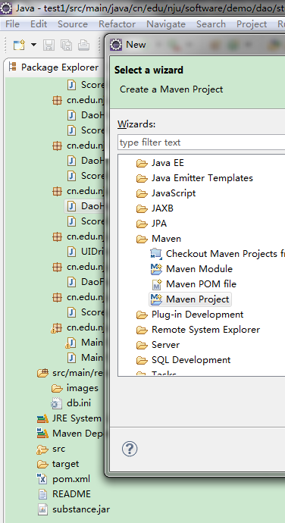
Step 2.1: Create New Maven Project
If you haven’t created any project, you can just create new one!
File->New->Maven Project…

Slide 35
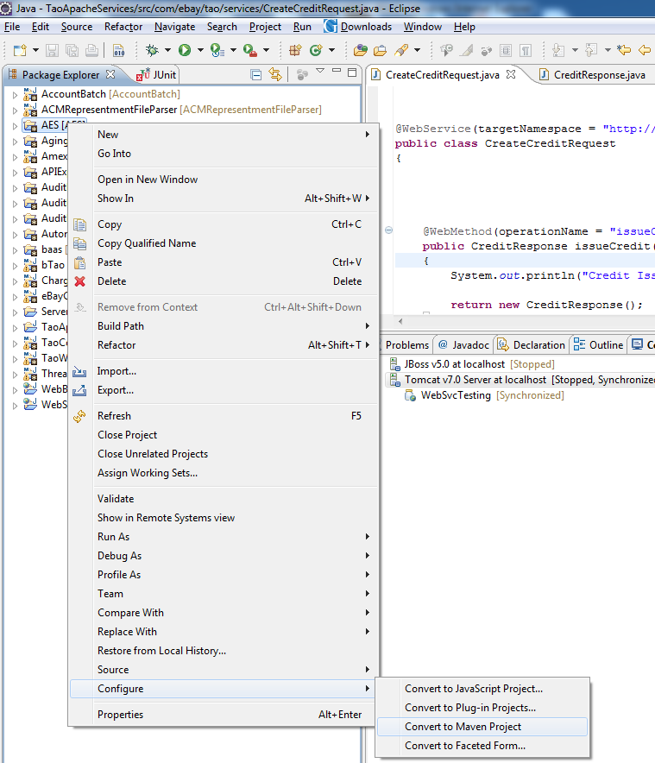
Step 2.2 Convert Java Project to Maven Project
If you already have a project, you can convert it to a maven project!
Right click on the java project you want to convert->Configure->Convert to Maven Project

Slide 36
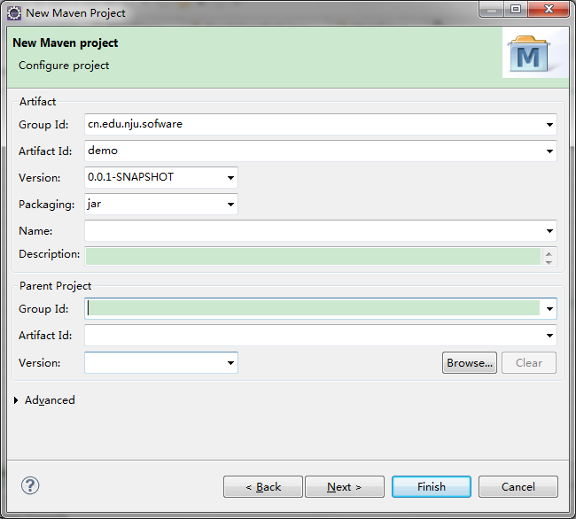
Step 2.3: Write Maven Project POM
Populate GroupId with cn.edu.nju.software, Artifact Id usually with the project name and the certain version,then hit Finish.

Slide 37
Step 3: Populating pom.xml
In order for you to build a java project in eclipse (or any IDE), you would have to populate the build path. There are 2 types of dependencies in your build path: internal (project) and external (3rd party jars) dependencies.
Internal dependencies: It means that your project depends on another java project (which you own).
External dependencies: It means that your project depends on some open source jars
Pom.xml file is an easy way to specify these dependencies. Better yet, Maven offers a public repository of the external dependencies like junit, log4j, etc so that we do not have to download these jars.
Example of external dependency in pom.xml:
<dependency>
<groupId>commons-dbcp</groupId>
<artifactId>commons-dbcp</artifactId>
<version>1.4</version>
</dependency>

Slide 38
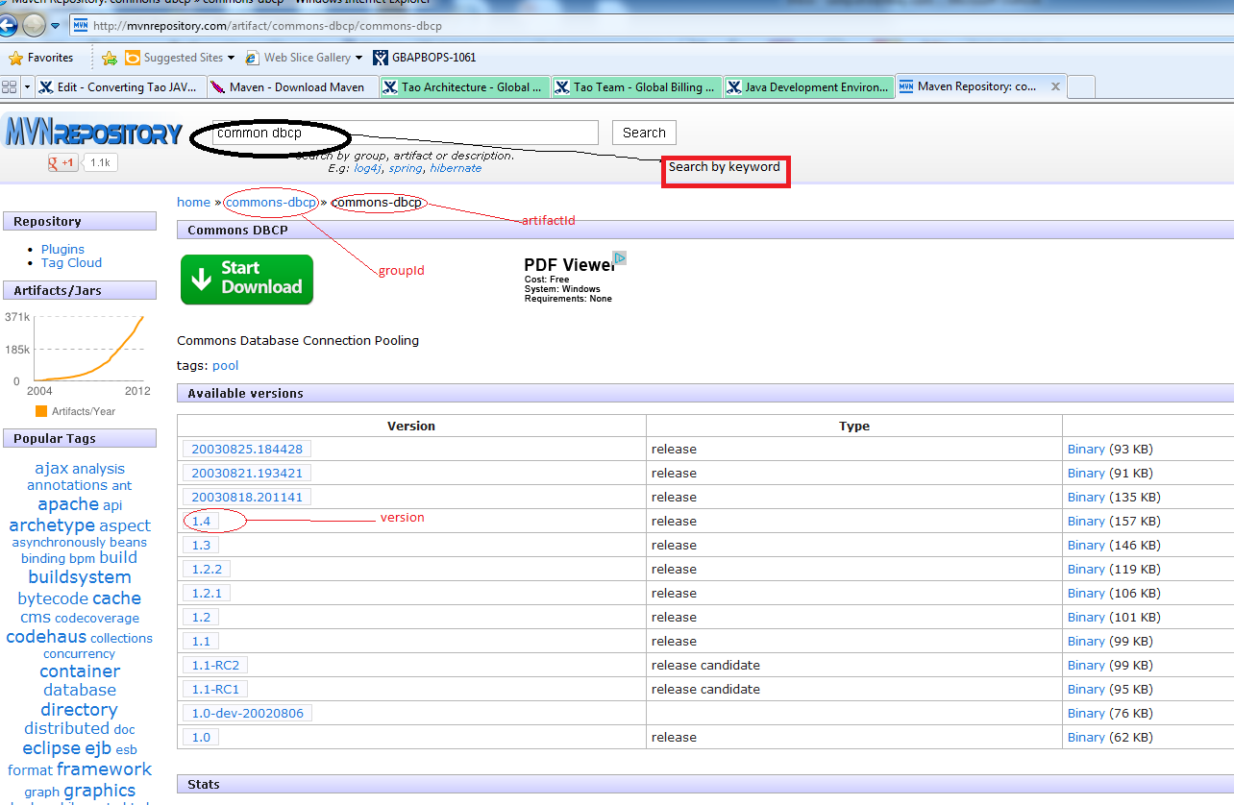
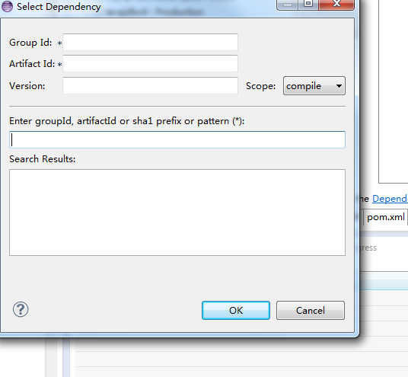
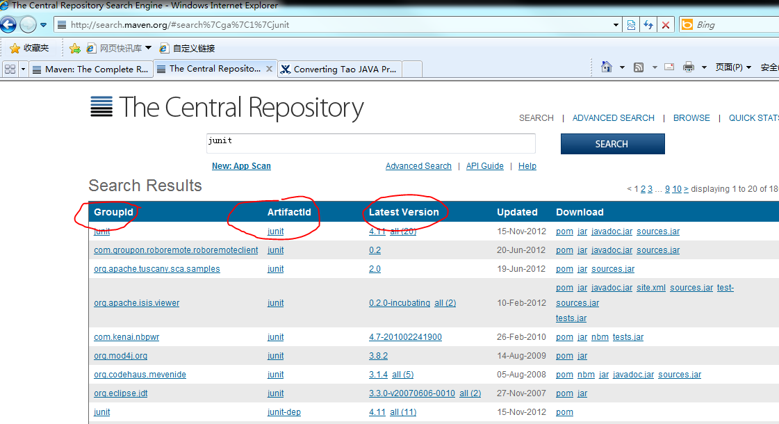
Several ways to find the dependencies
http://mvnrepository.com/
3. eclipse
2. http://search.maven.org/

Slide 39
Step 4 to Step 6 can be repeated as described in Integrate Policy

Slide 40
Coding
Step 4: Coding
Coding
Coding
Coding
Coding
Coding

Slide 41
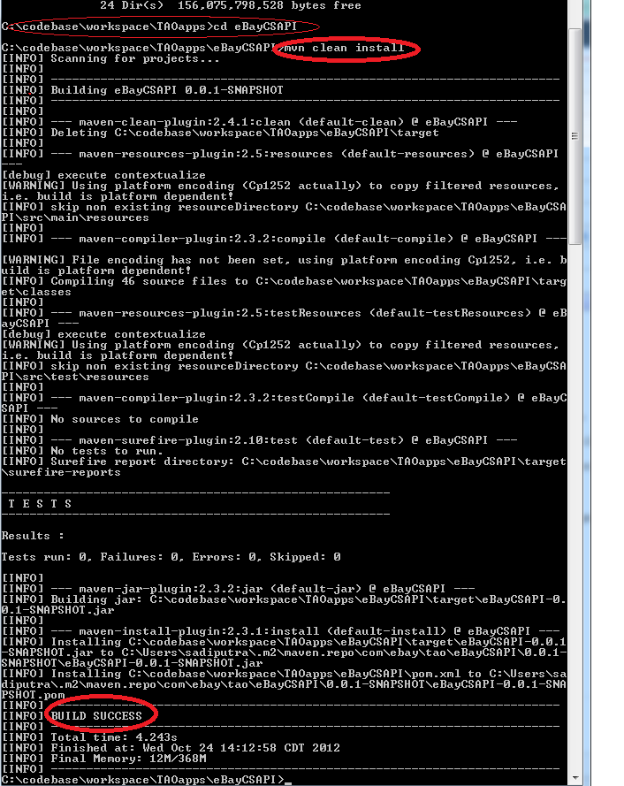
Step 5: Local maven building
cd to your java project
type: mvn clean install
that command compiles all your java code and retrieving all external dependencies from mvn repository and run your test cases. If you want to skip running the test cases, use command mvn clean install -DskipTests

Slide 42
Step 6: Using Hudson to integrate your code

Slide 43
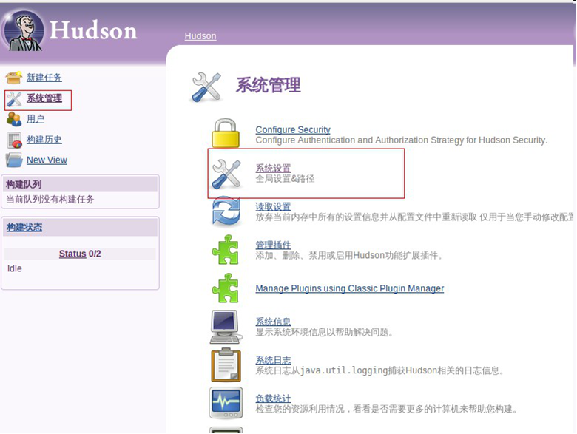
6.1: 系统设置

Slide 44
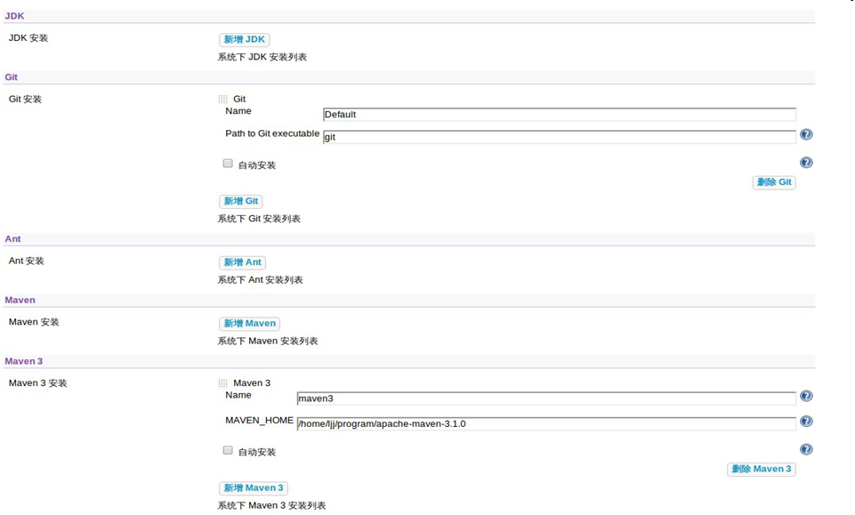
6.2: 指定位置

Slide 45
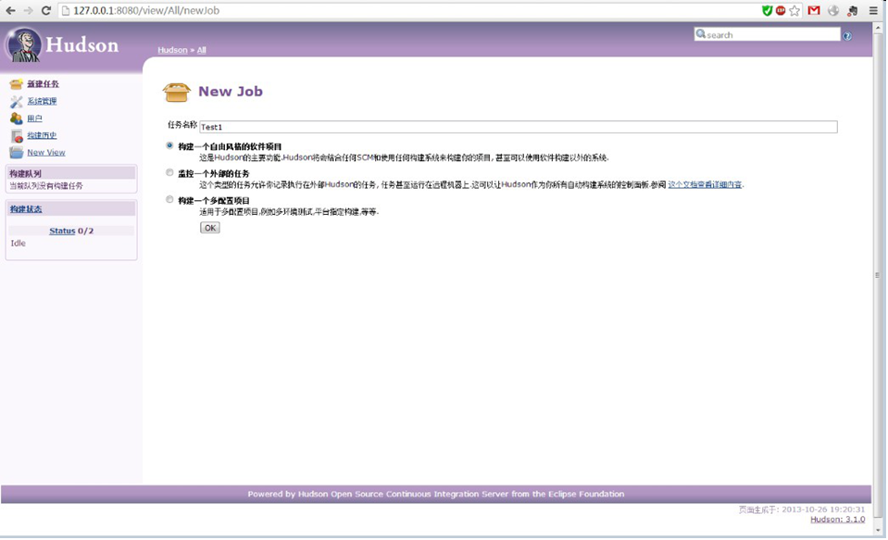
6.3: 新建任务

Slide 46
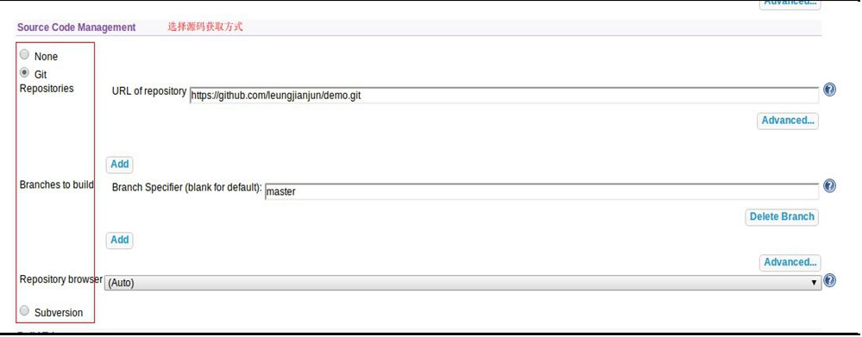
6.4: 导入项目

Slide 47
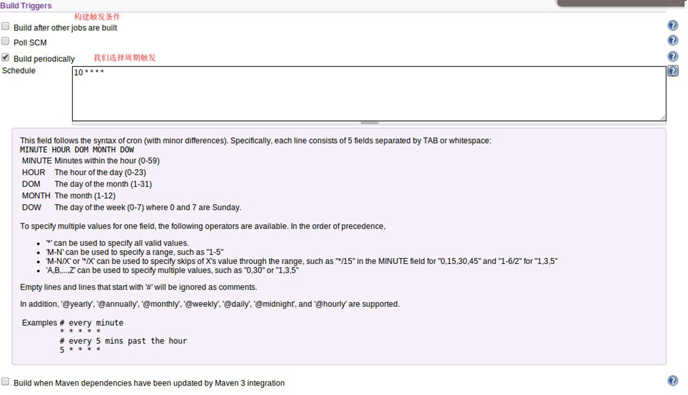
6.5: 编译触发设置

Slide 48
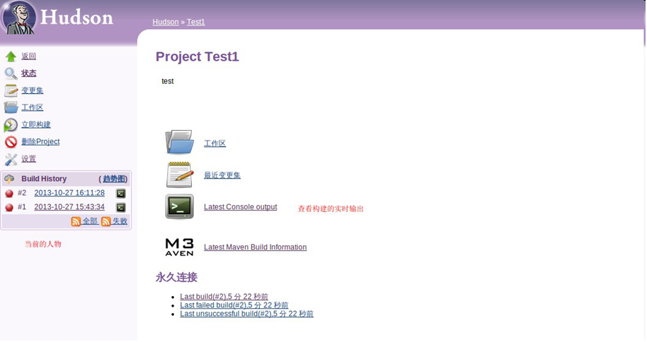
6.6: Hudson运行构建

Slide 49
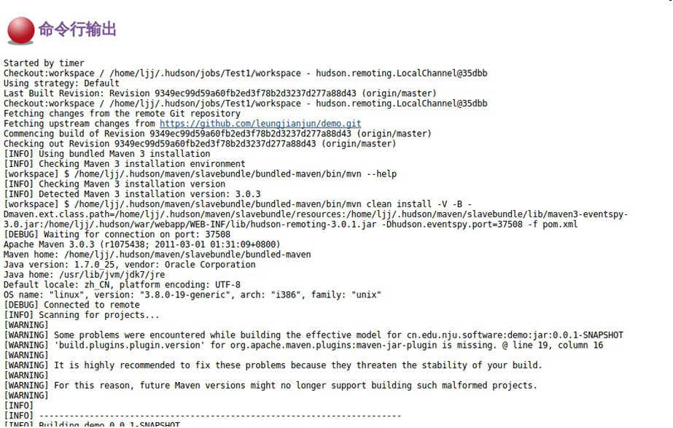

Slide 50
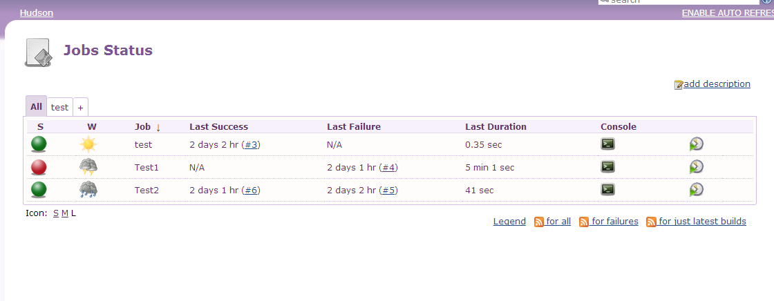
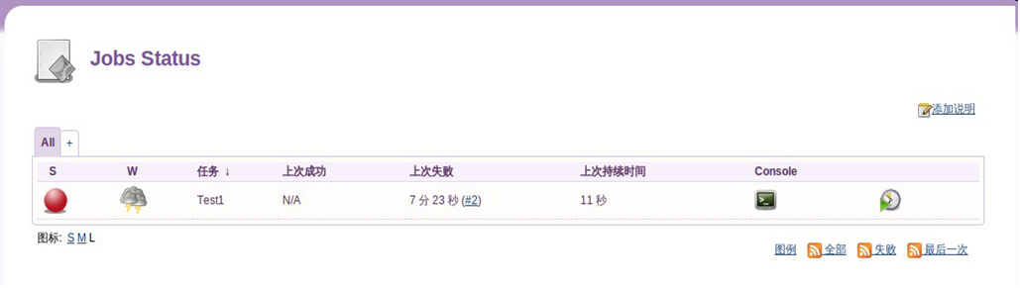
6.7: 工作状态

Slide 51
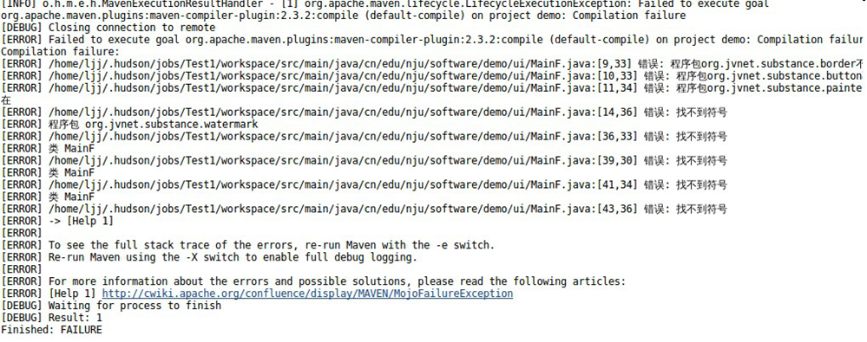
6.8: 错误提示
我们在此引入了一个错误，界面中用到了substance.jar 这个依赖，而这个依赖在maven repo中没有找到，故hudson在编译时，所有引用这个jar中的类都找不到导致编译失败。

Slide 52
Project Presentation

Slide 53
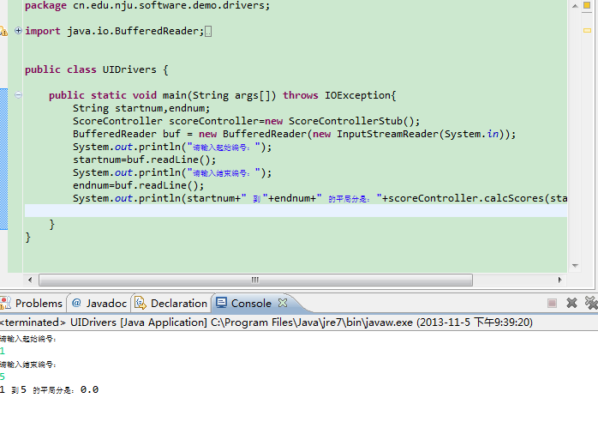
Use driver & stub：

Slide 54
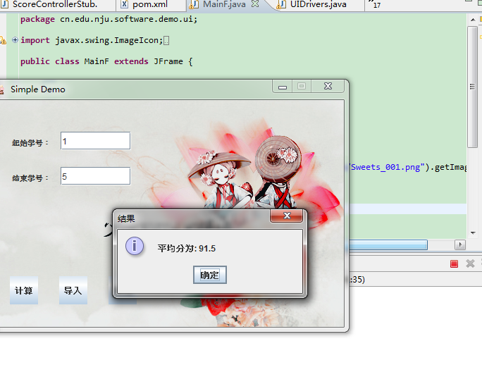
Replace with real implementation

Slide 55
Part 3: Q & A

Slide 56


Slide 57
Thank you!

